Slide 1
United Energy Product Migration Incident: A controlled response plan
Briefing for the Kraken transformation Director
Notes:
“One of our migration feeds has assigned twenty thousand customers to the wrong product. Here is how I contain the issue, resolve it safely, and prevent recurrence.”

Slide 2
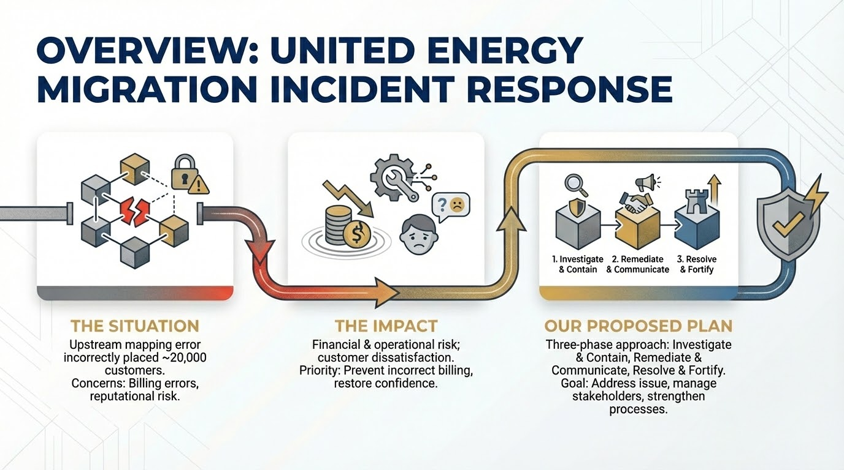

Slide 3
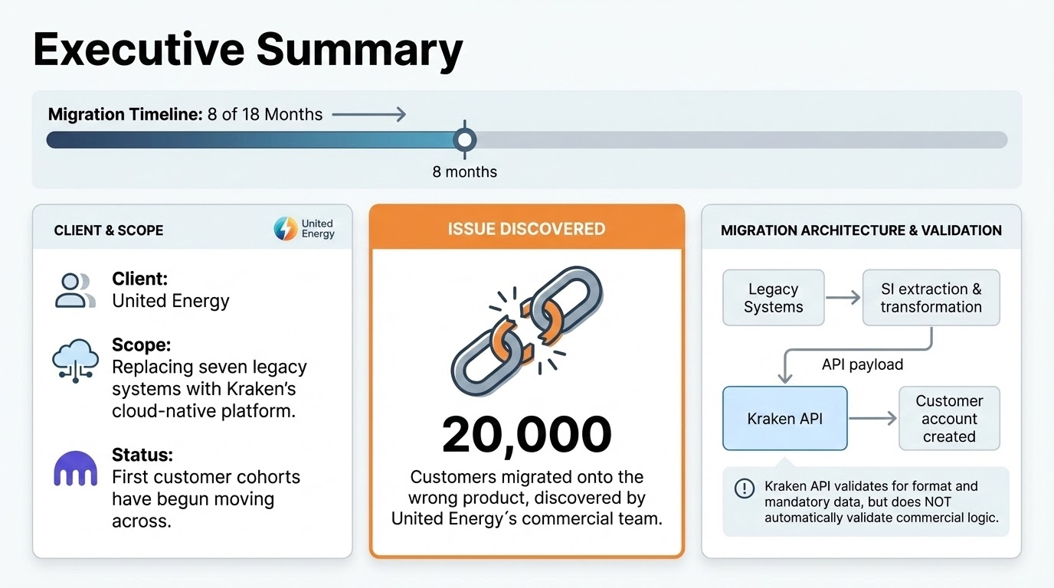

Slide 4
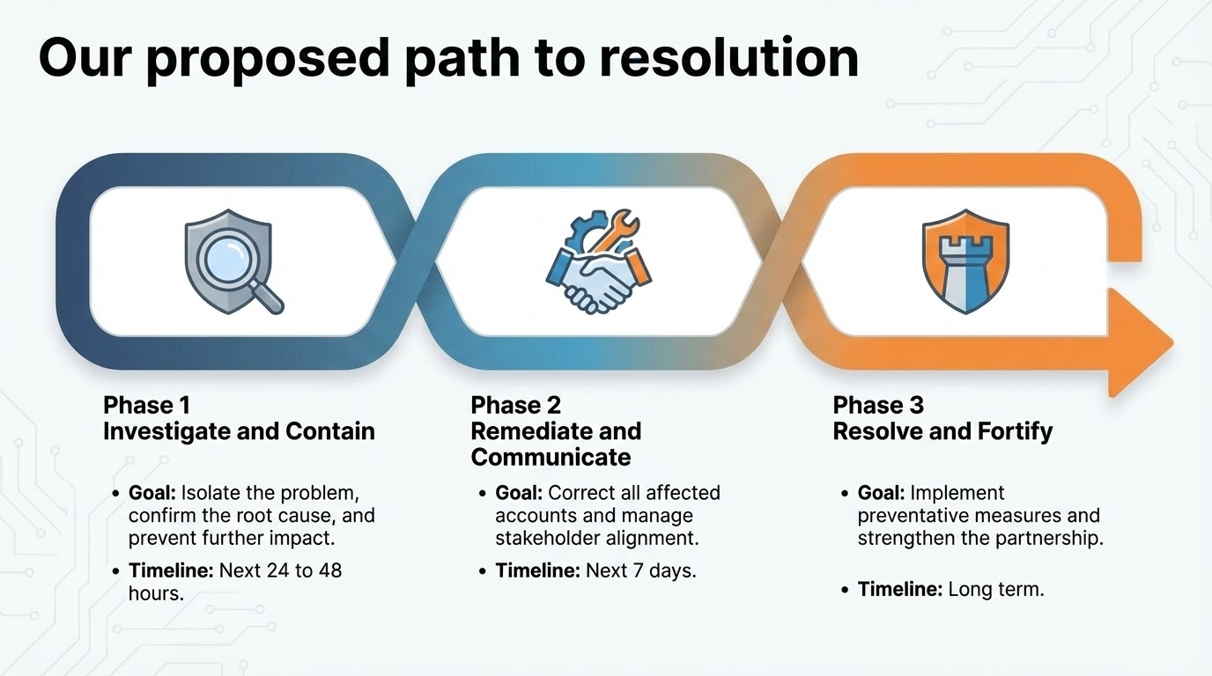

Slide 5
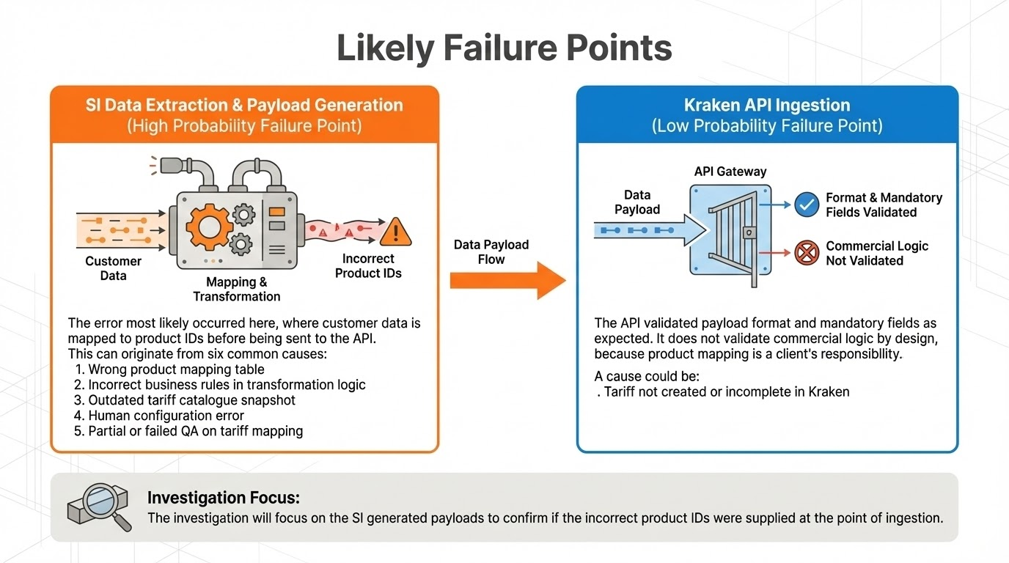
Notes:
Root Cause Analysis The Data Journey and Likely Failure Points
High probability (SI Data Extraction and Payload Generation): The error most likely occurred here, where customer data is mapped to product IDs before being sent to the API.
Low probability (Kraken API Ingestion): The API validated payload format and mandatory fields as expected. It does not validate commercial logic by design, because product mapping is a client´s responsibility.
This can originate from six common causes: 1. Wrong product mapping table: The lookup table used by the SI contained incorrect correspondences.
2. Incorrect business rules in transformation logic: The SI used incorrect conditional logic for tariff assignment.
3. Outdated tariff catalogue snapshot: The SI used an older version of the tariff catalogue and mapped codes to products that were changed or deprecated.
4. Tariff not created or incomplete in Kraken: The required tariff did not yet exist or was only partially configured. The SI maps customers to a placeholder, fallback tariff or to the closest available tariff in Kraken, which does not match the legacy tariff rules or rates.
5. Human configuration error: The SI or Kraken tariff configuration error.
6. Partial or failed QA on tariff mapping: The SI did not fully test the mapping before migration.
The investigation will focus on the SI generated payloads to confirm if the incorrect product IDs were supplied at the point of ingestion.

Slide 6
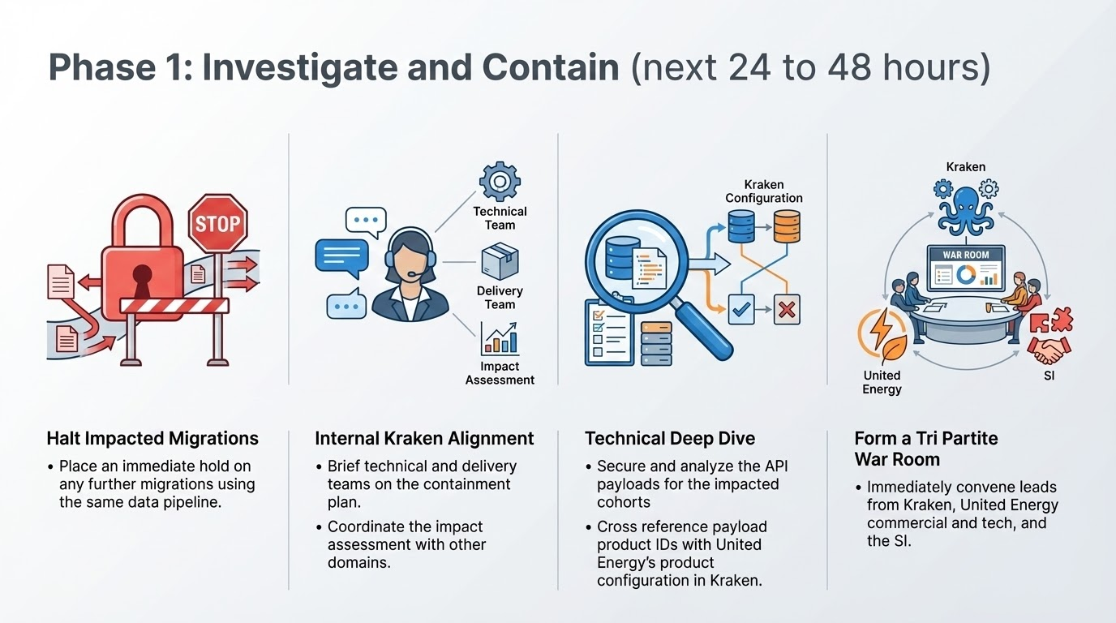

Slide 7
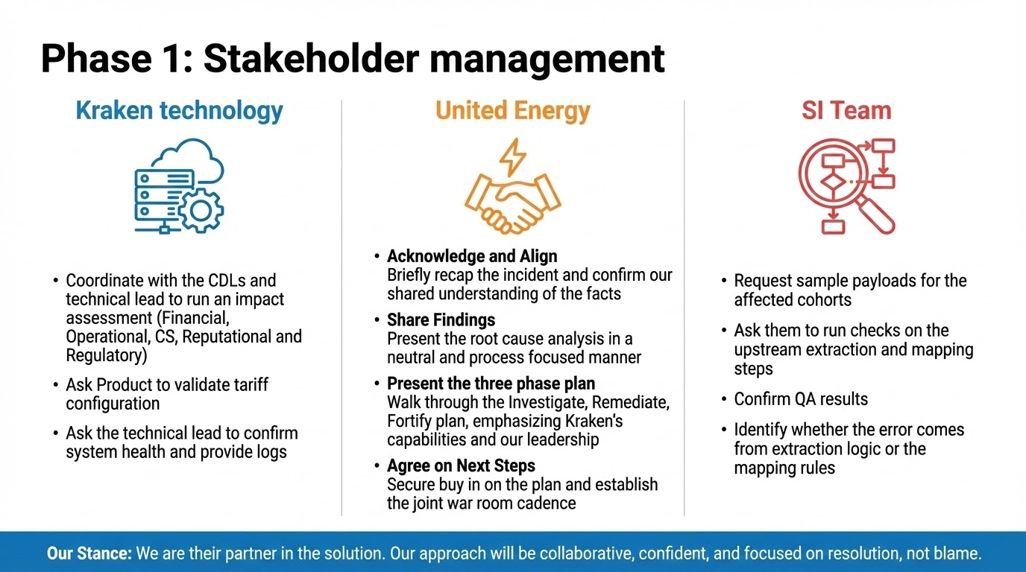

Slide 8
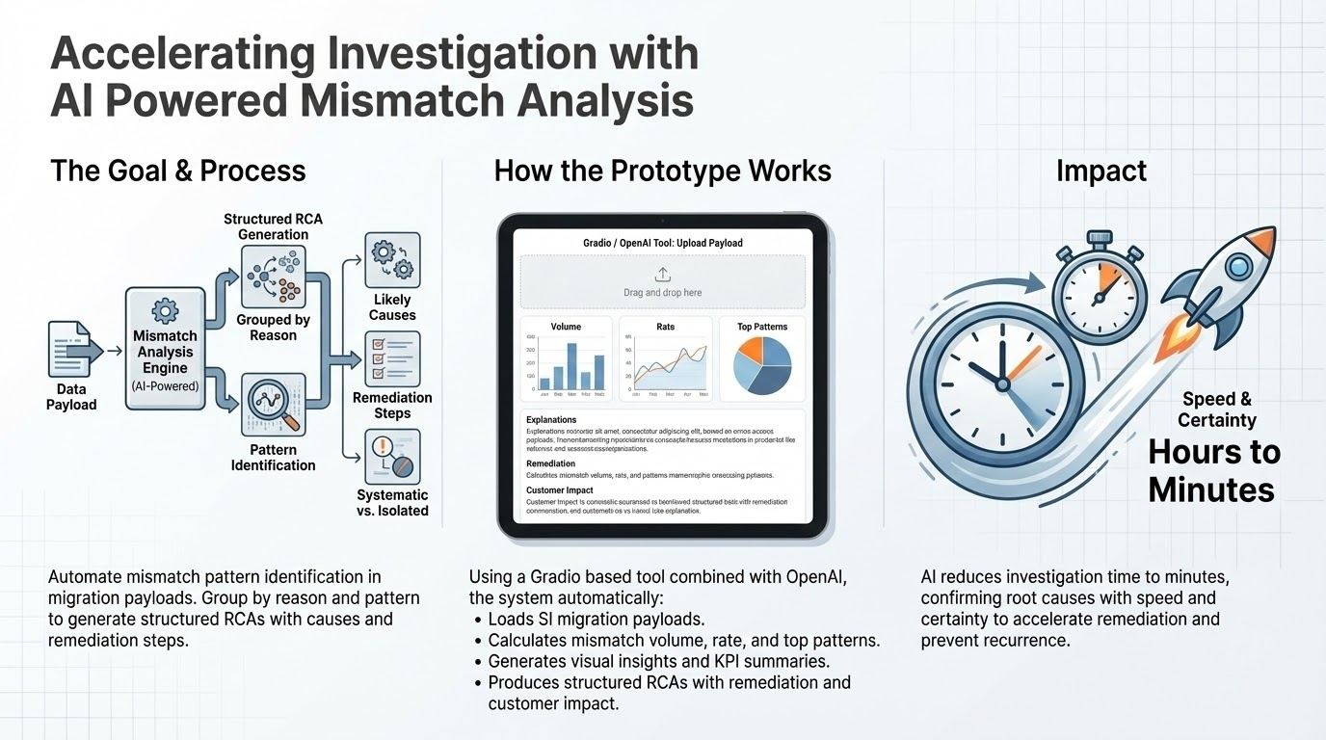

Slide 9
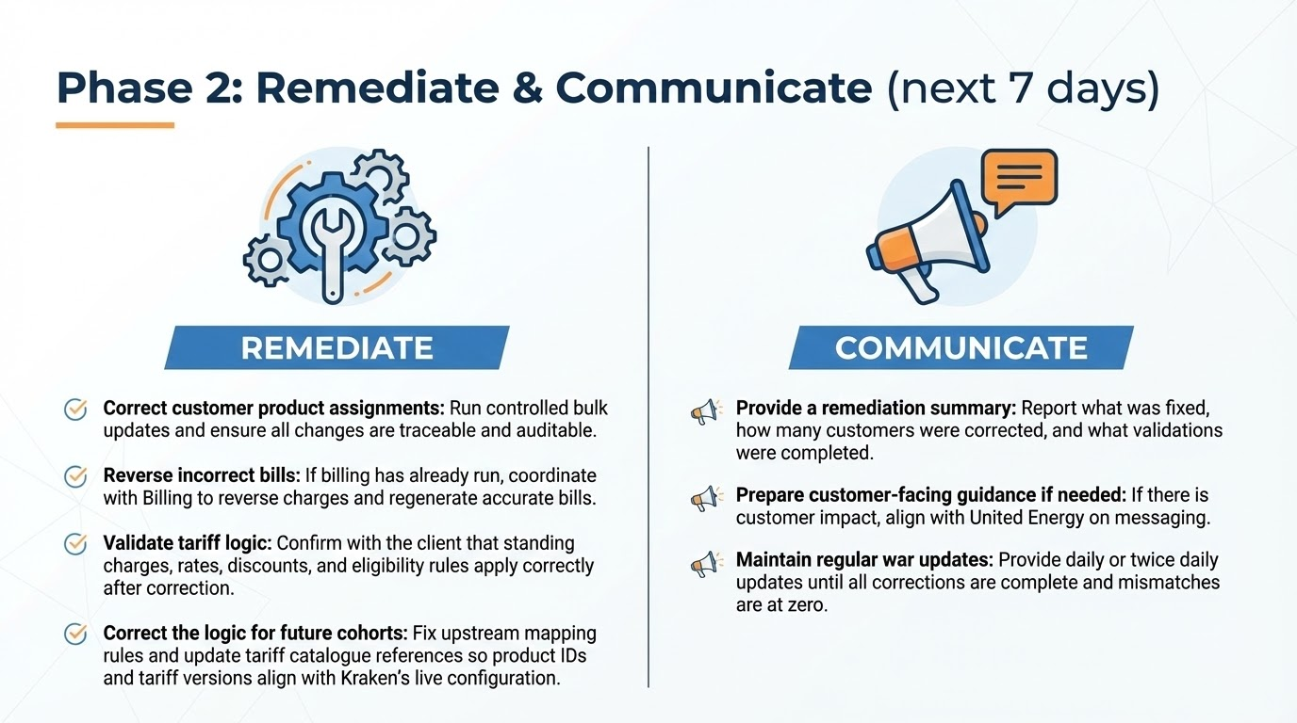

Slide 10
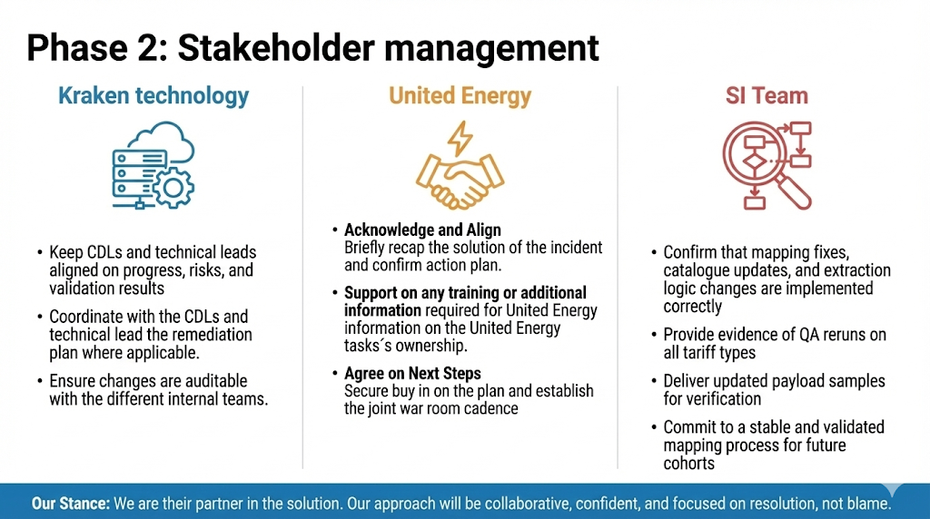

Slide 11
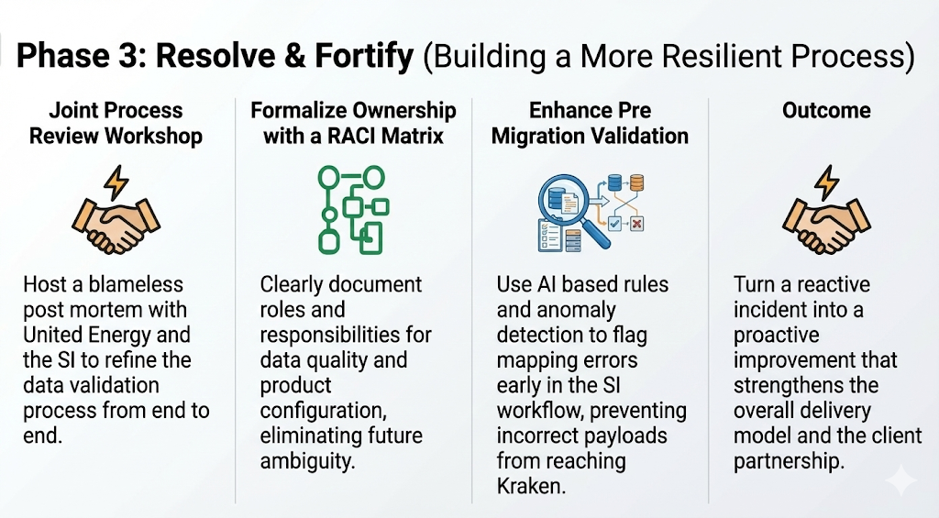

Slide 12
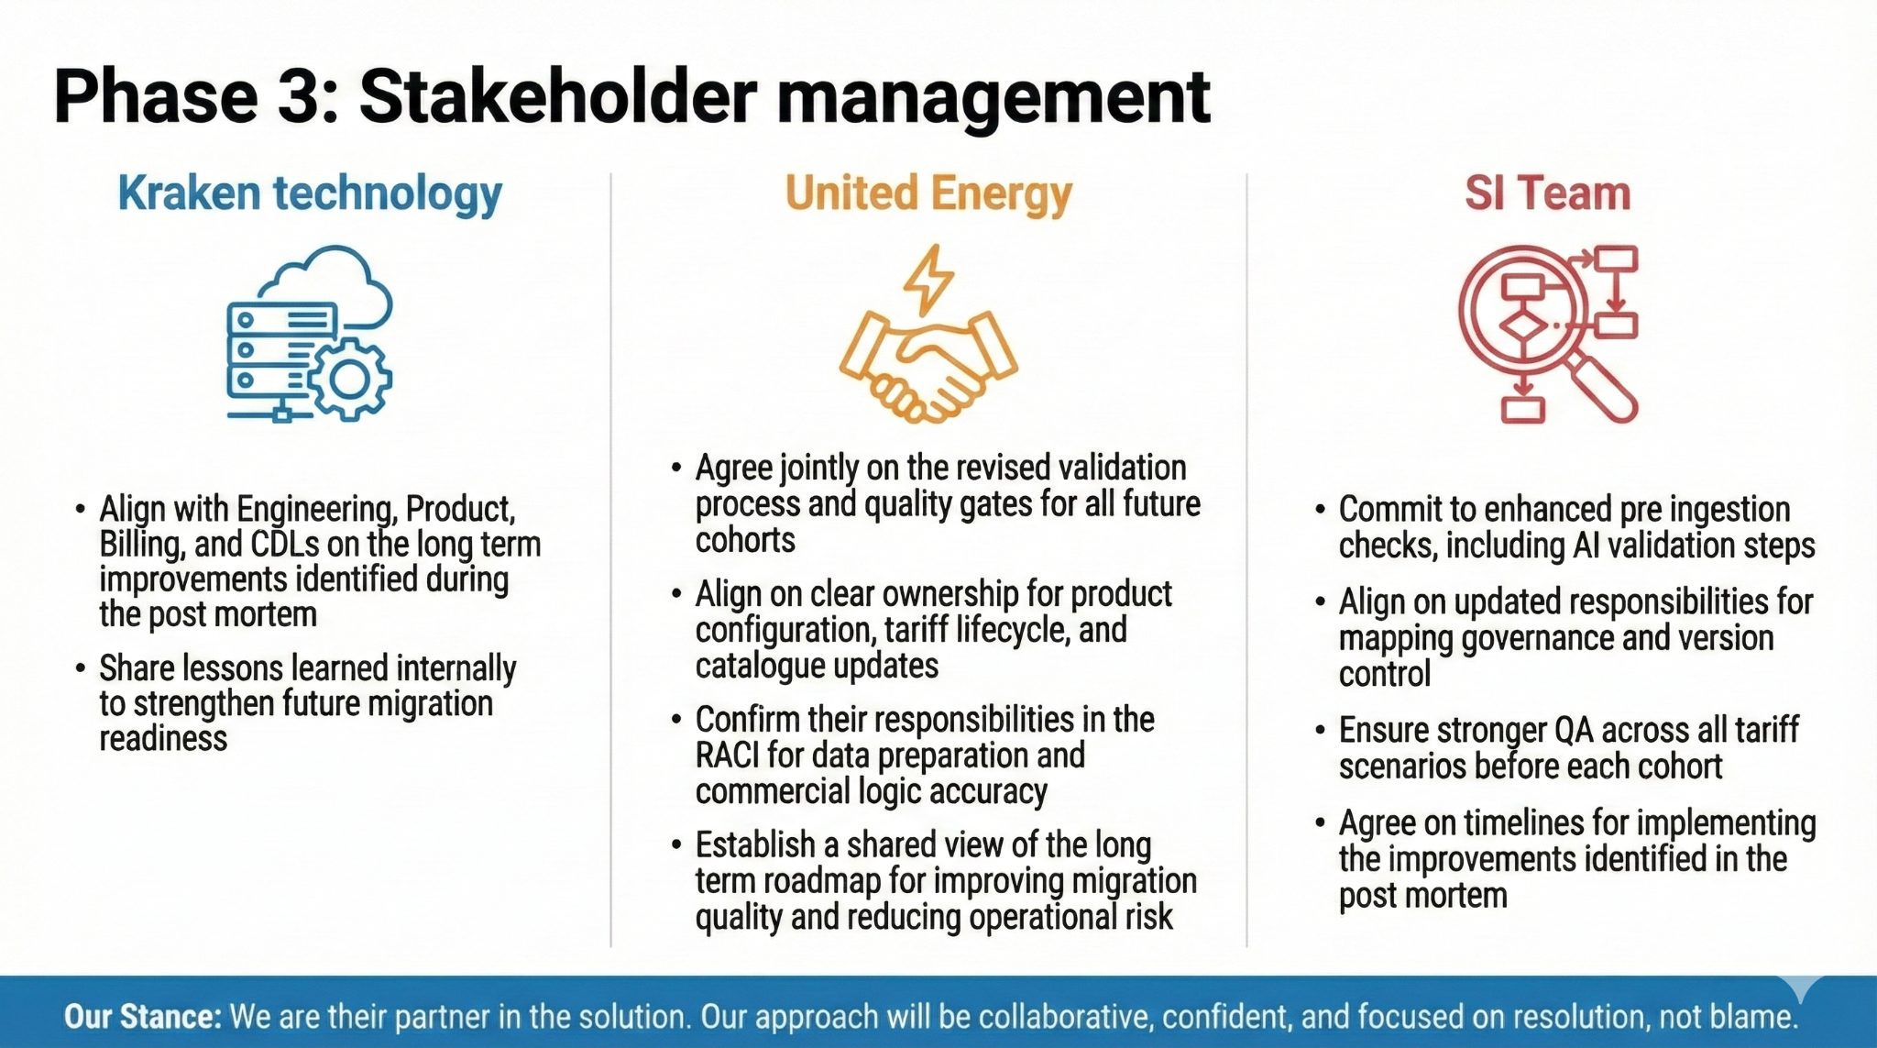

Slide 13
